Slide 1


PAGE 1
multi domain threat detection system
Akshay c k (AWH23MCA-2006)
Guide: Muhammad Muhsin k

Slide 2

PAGE 2
overview
Unified ML system for detecting cyber threats and image forgery.
Scope:
Real-time phishing detection.
Dynamic spam classification.
Automated image authentication.
Solves limitations of manual/rule-based methods.

Slide 3
PAGE 3
system analysis
Existing System
Phishing Detection:
Static rules - High false negatives.
Spam Filters:
Cannot adapt to new spam techniques.
Image Forgery:
Manual checks - Slow and unreliable.

Slide 4
PAGE 4
system analysis
Proposed System
Phishing Detection:
Analyze URL structure (length, special characters)
Provides feature importance scores
Spam Filters:
Identifies spam patterns in email content and Analyzes embedded links
Image Forgery:
Automatic feature extraction and Recognizes local manipulation patterns

Slide 5
PAGE 6
phishing detection
Phishing is a social engineering attack where criminals masquerade as trustworthy entities to steal sensitive data
Objective:
Develop machine learning-based system to predict whether a website is phishing or legitimate.
Methodology:
Utilize the Random Forest algorithm to analyze user-input URLs.
Predict phishing or legitimate websites based on URL characteristics.
Significance:
Phishing attacks are a growing concern. This feature helps safeguard users against potential security breaches.

Slide 6
PAGE 7
Spam mail classifaction
Spam emails are often irrelevant messages sent to many users at once
Objective:
Design a machine learning system to classify email messages as spam or not spam.
Methodology:
Train machine learning models on user-input email messages using CNN algorithm.
Identify spam or legitimate emails based on patterns and text analysis.
Significance:
Spam emails often lead to security threats and data theft. This feature helps mitigate these risks.

Slide 7
Image forgery
PAGE 8
Image forgery means changing or faking pictures to trick people. where someone alters an image to show something that isn't real.
Objective:
Develop a machine learning-based system to detect whether an image has been manipulated or is authentic.
Methodology:
Leverage machine learning algorithms to analyze user-uploaded images.
Predict image forgery or authenticity based on tampering markers.
Significance:
Image authenticity is vital across various domains, This feature helps detect tampered images.

Slide 8
PAGE 9
modules
Admin Module
Login
View Users
Change Password
View App Reviews
View Complaints
Send Reply

Slide 9
PAGE 10
modules
User Module
Registration
Login
View Profile
Edit Profile
Send Complaint
View Reply
App Review
Image Forgery Detection
Email Spam Detection
URL Phishing Detection

Slide 10
PAGE 11
System REQUIREMENTs
Hardware Environment
Processor: Ryzen 3 or above
Hard Disk: 512 GB or above
RAM: 8 GB or above
Software Environment
Operating System: Windows 8 or above
Front End: HTML
Back End: MySQL
Programming Language: Python, Dart
Browser: Google chrome / Mozilla Firefox

Slide 11

PAGE 12
screen shots
Admin Module

Slide 12
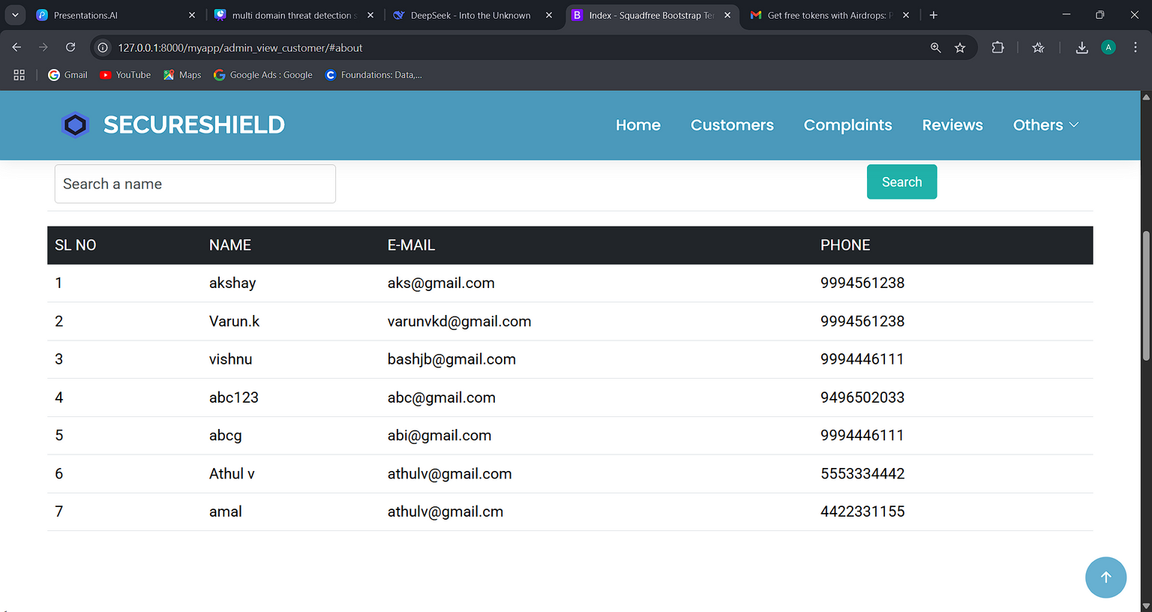
PAGE 12
screen shots
Admin Module

Slide 13
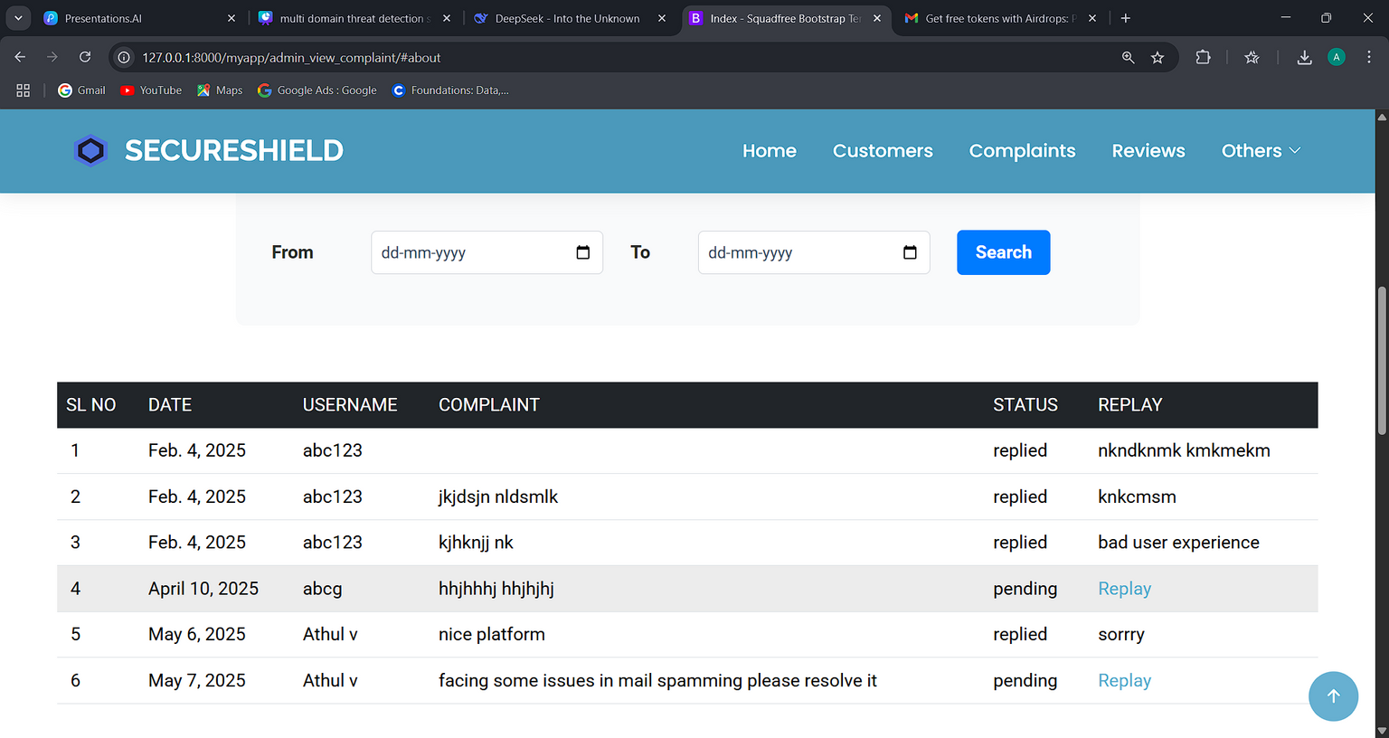
PAGE 12
screen shots
Admin Module

Slide 14
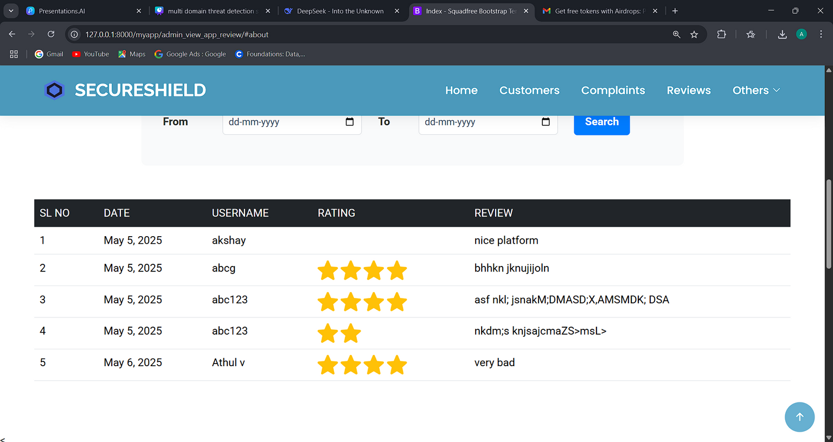
PAGE 12
screen shots
Admin Module

Slide 15
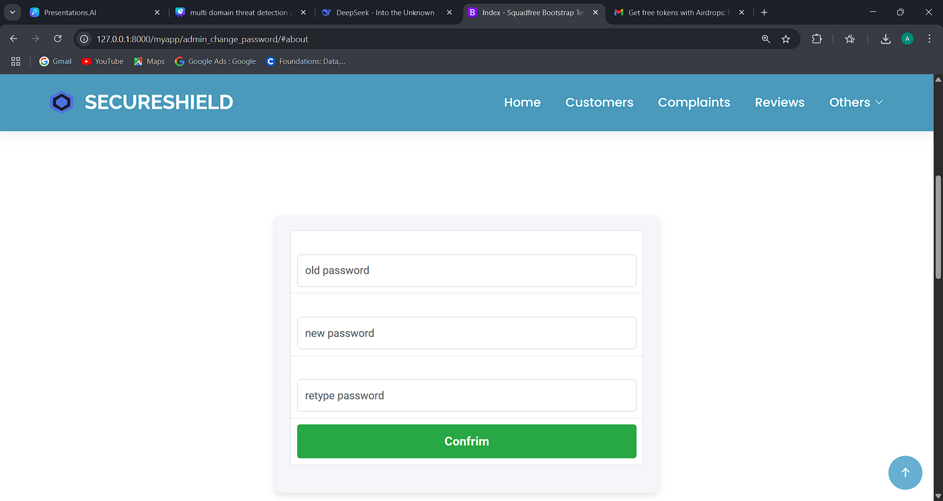
PAGE 12
screen shots
Admin Module

Slide 16
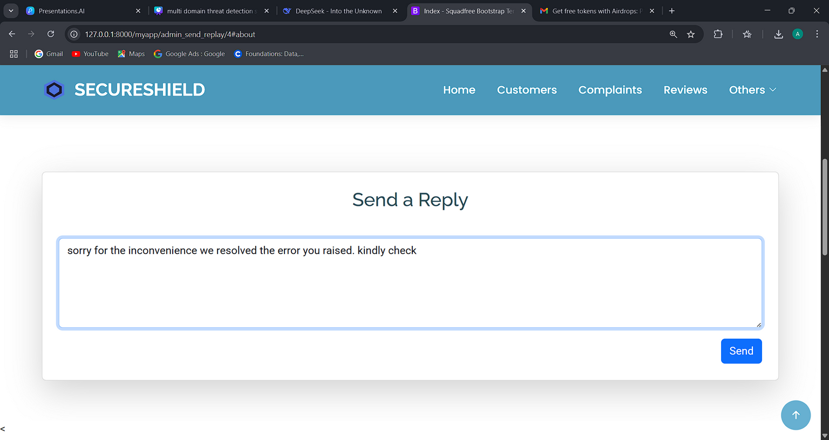
PAGE 12
screen shots
Admin Module

Slide 17
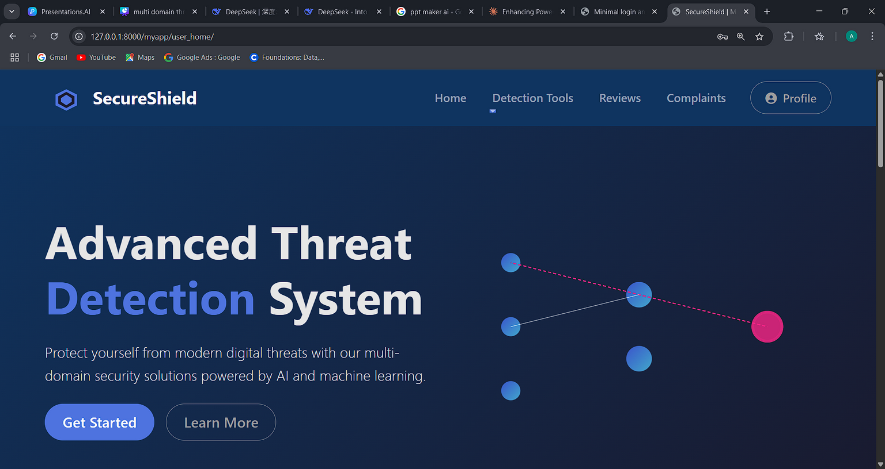
PAGE 12
screen shots
User Module

Slide 18
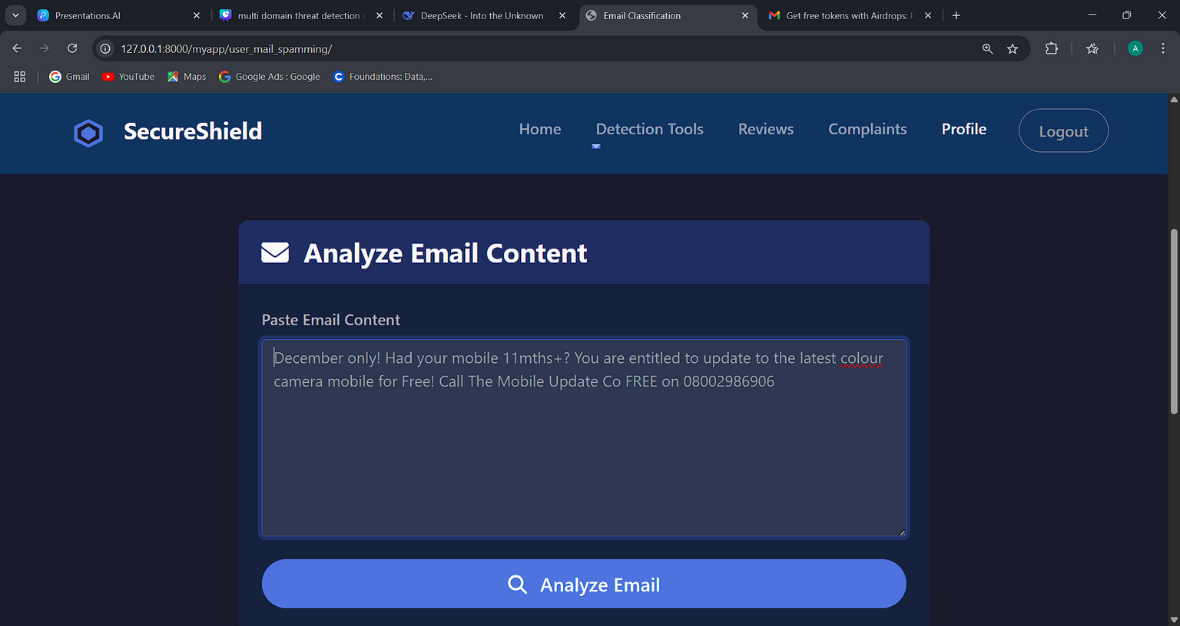
PAGE 13
screen shots
User Module

Slide 19
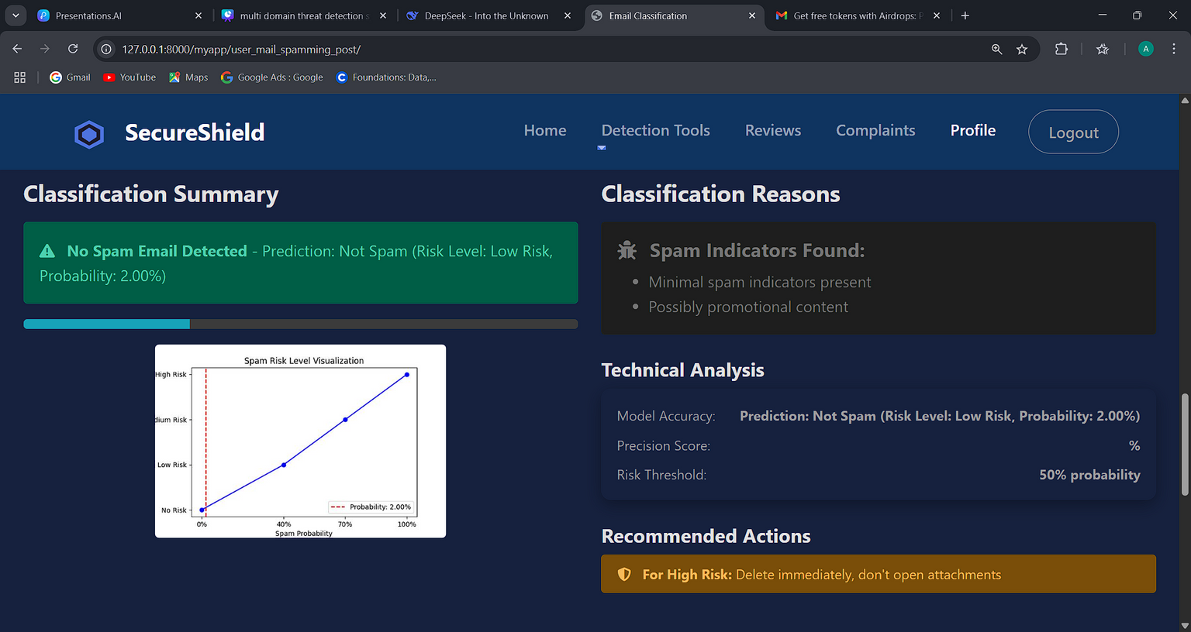
PAGE 14
screen shots
User Module

Slide 20
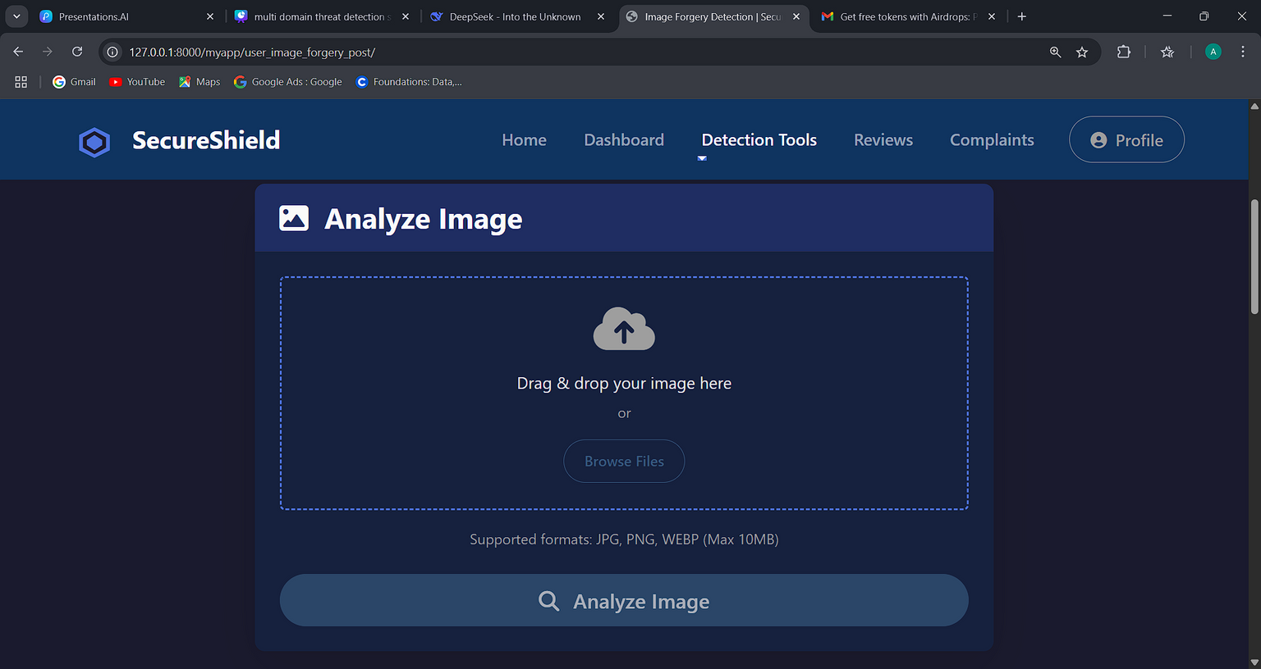
PAGE 15
screen shots
User Module

Slide 21
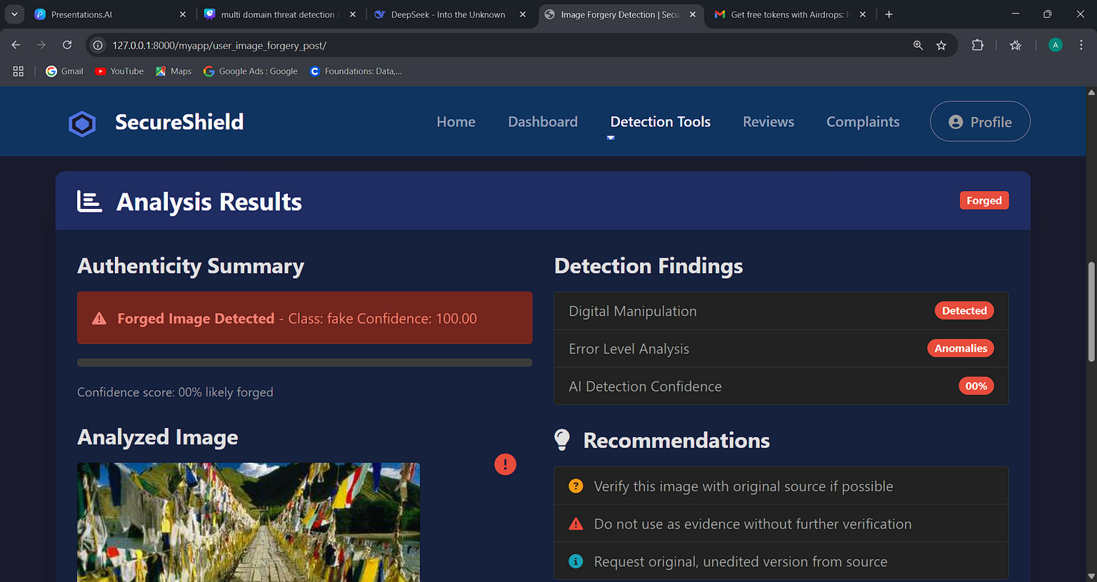
PAGE 16
screen shots
User Module

Slide 22
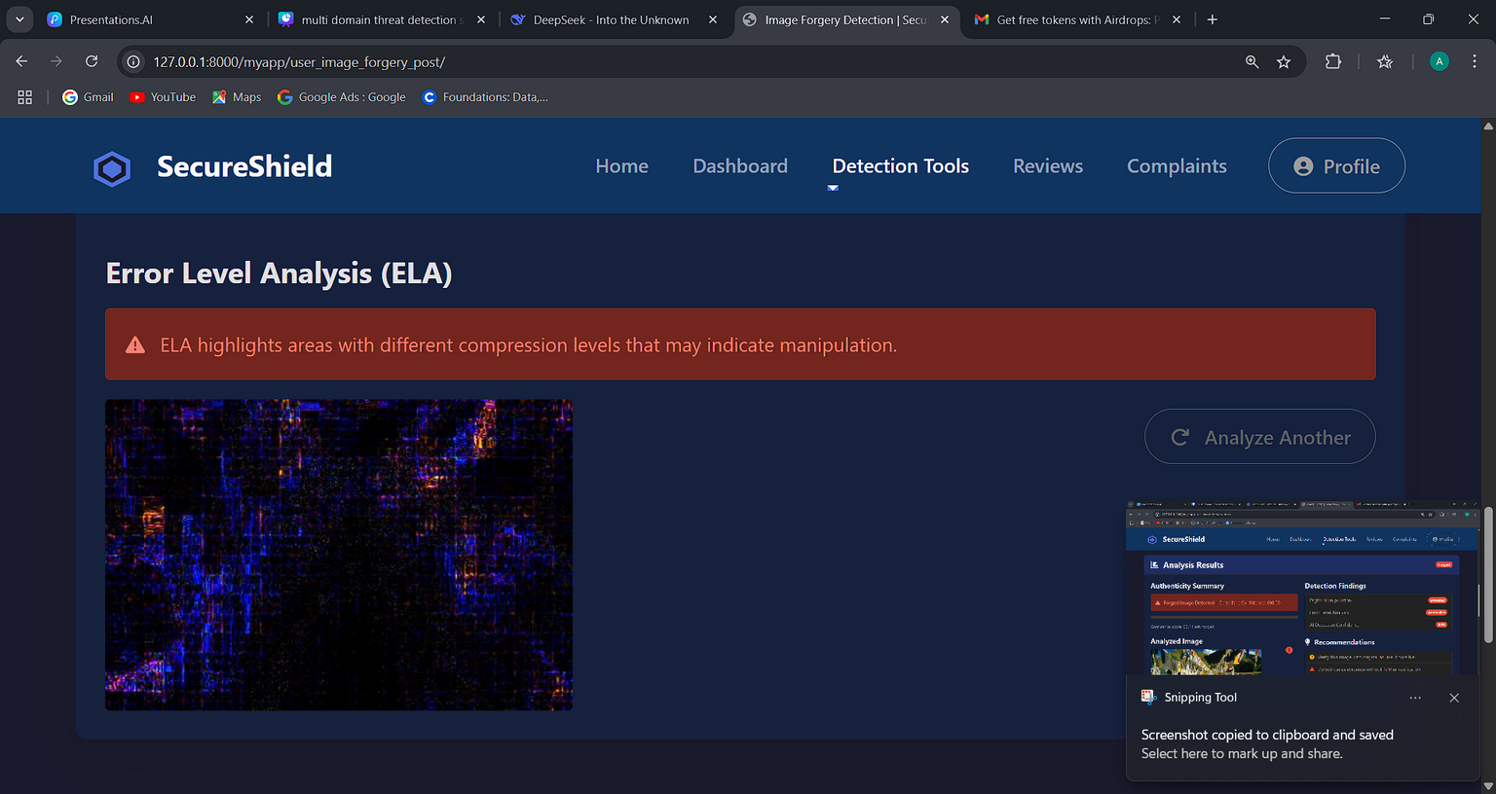
PAGE 17
screen shots
User Module

Slide 23
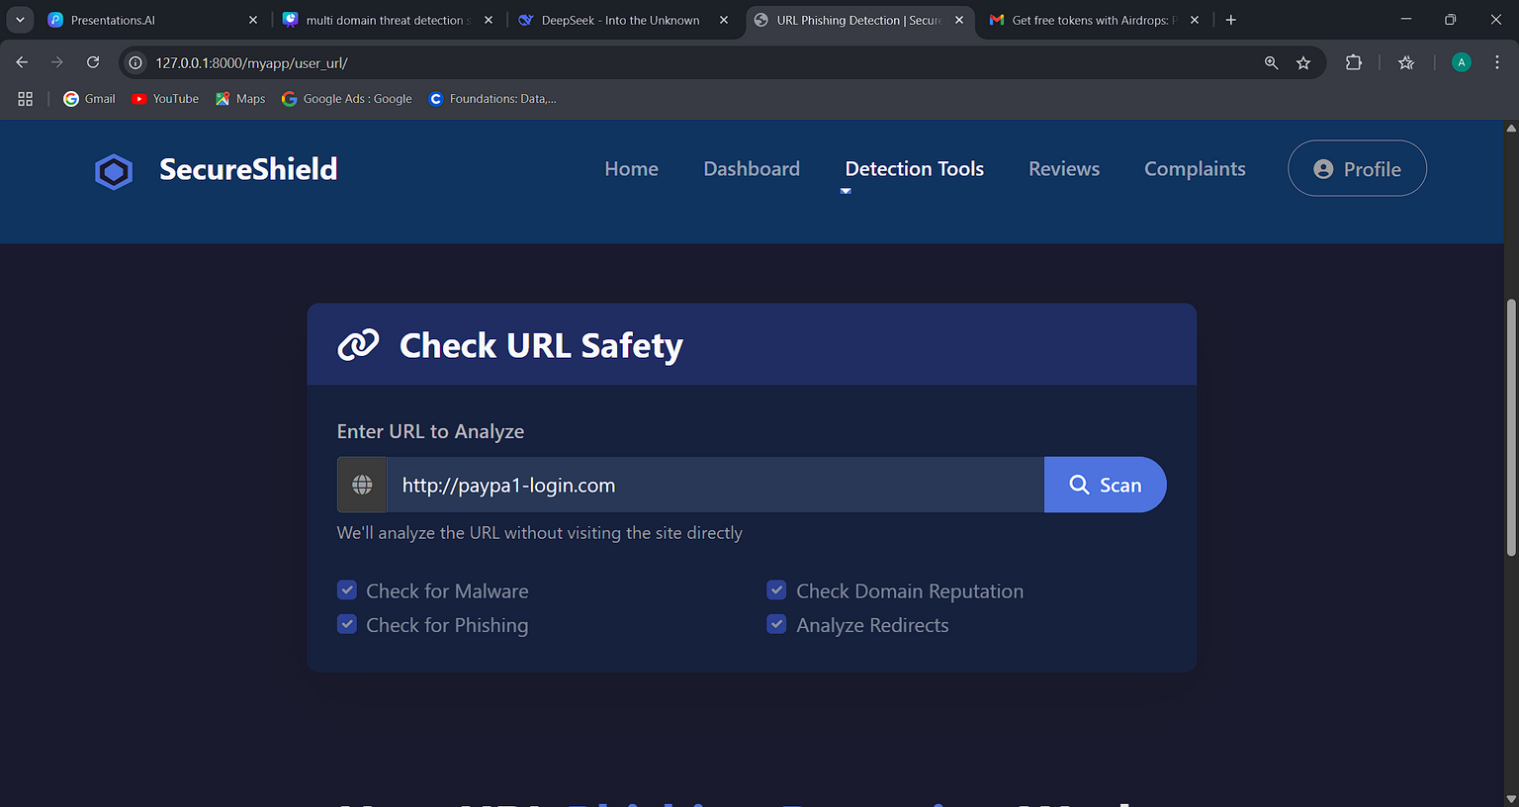
PAGE 18
screen shots
User Module

Slide 24
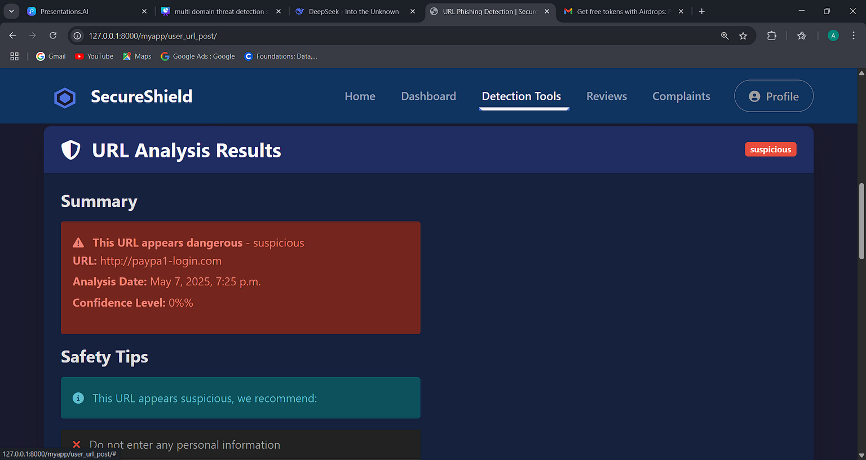
PAGE 19
screen shots
User Module

Slide 25
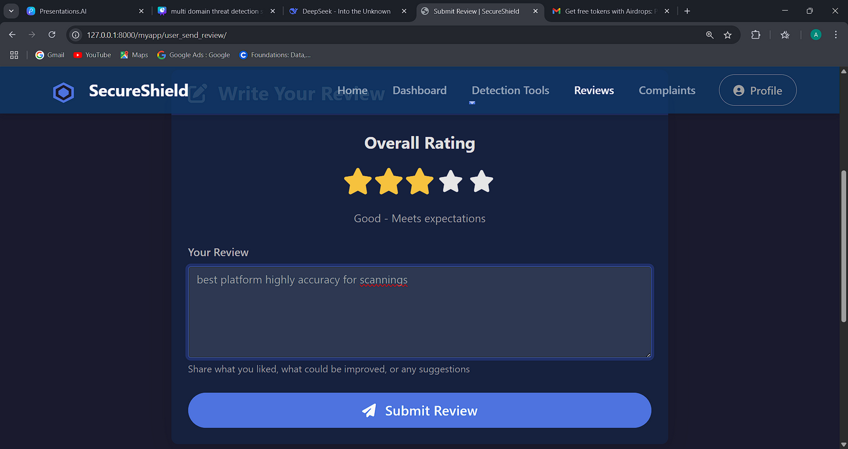
PAGE 20
screen shots
User Module

Slide 26
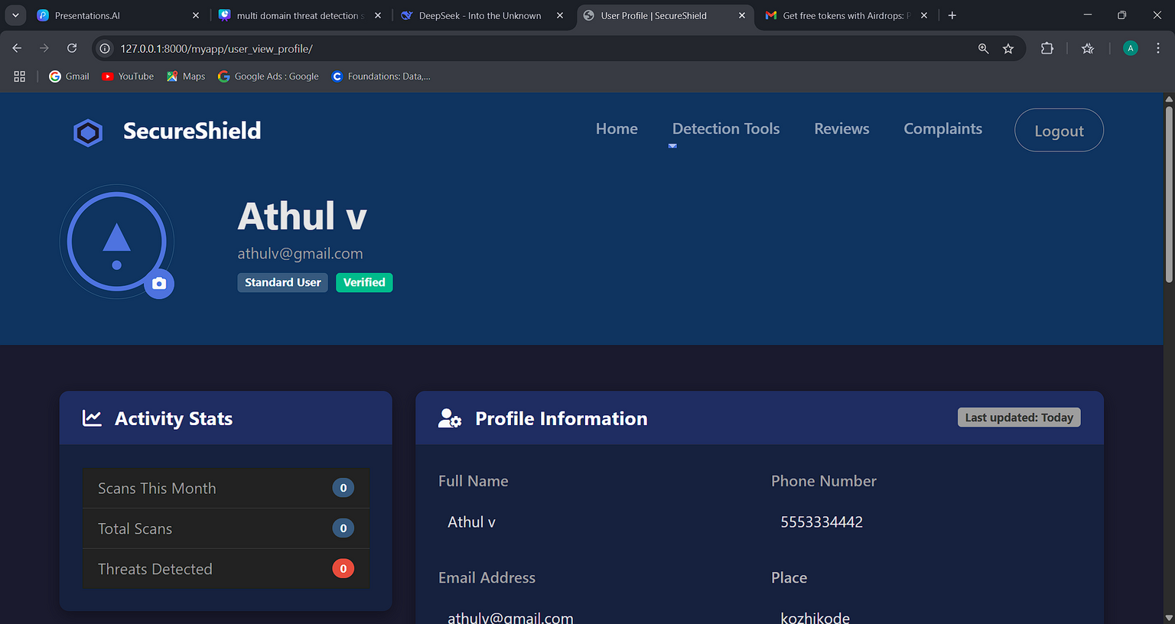
PAGE 21
screen shots
User Module

Slide 27
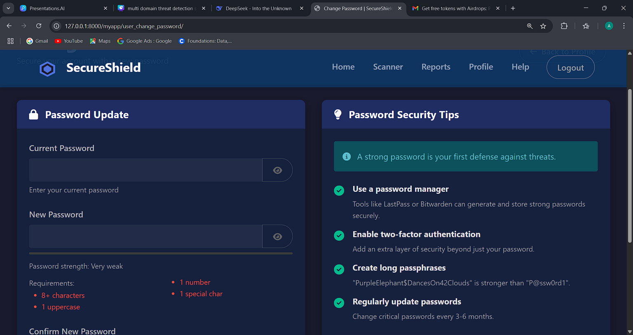
PAGE 22
screen shots
User Module

Slide 28
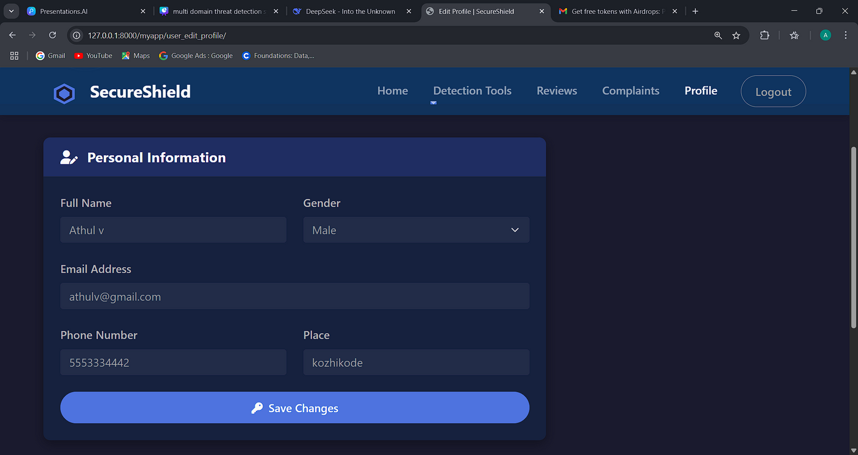
PAGE 23
screen shots
User Module

Slide 29
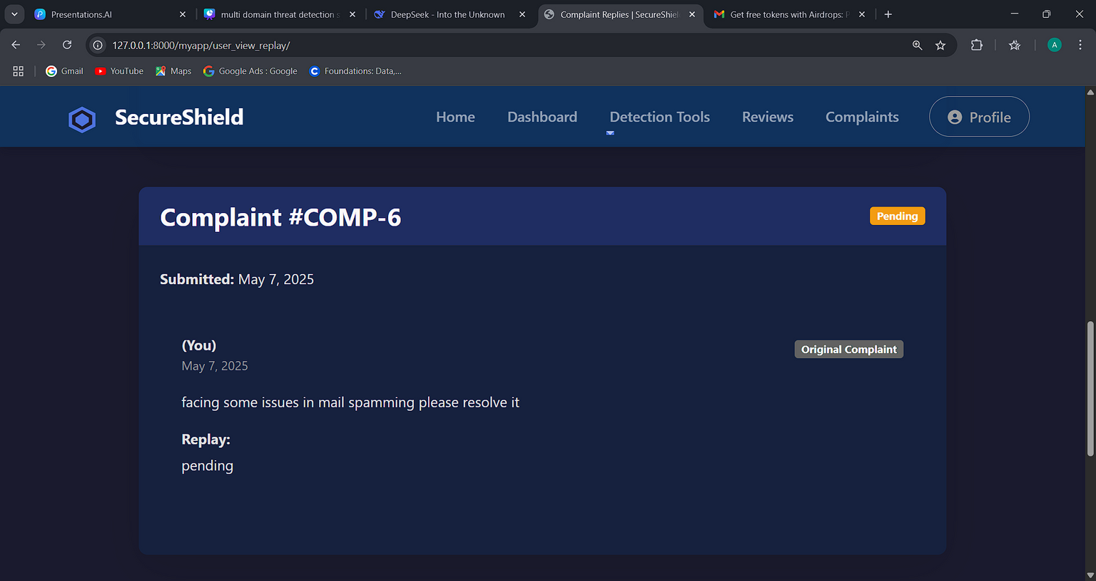
PAGE 24
screen shots
User Module

Slide 30
PAGE 25
thank you

